Slide 1
Asynchronous JavaScript (And XML)
BALAZS JUHASZ
DEBRECEN
19/03/2020

Slide 2

About me
BalÁzs JuhÁsz
Junior Software Engineer
Working at EPAM since 2019 May

Slide 3
Agenda
1
HTTP – request, response, status codes
2
The old school way
3
The asynchronous way
4
Callbacks
5
Promises
6
Fetch API
7
Exercises

Slide 4
HTTP

Slide 5
HyperText Transfer Protocol
Application protocol for distributed, collaborative and hypermedia information systems
Based on request-response protocol in client-server computing model
Stateless communication – no stored data
History:
Tim Berners Lee & CERN
1991: v0.9
1996: v1.0 (RFC 1945)
1997: v1.1 (RFC 2068) – most widely known and used
2015: v2.0 (HTTP/2 – RFC 7540) – fast, but barely used

Slide 6
HTTP Request
Client to server communication
Contains header information and body (if needed)
Structure:
POST /create-user HTTP/1.1
Host: localhost:3000
Content-type: application/json
{ “name”: ”John”, ”age”: 35 }
GET: retrieve information from the server using the given URI, expected to retrieve only and should have no effect on the data
POST: send data to server – usually to store new information, upload data via HTML forms
PUT: replace already existing information on the server; usually for update
DELETE: remove already existing data from the server
Others:
HEAD – almost same as GET, but no body is expected in the response
CONNECT – establish a tunnel to the server
OPTIONS – describe the communication options for the target resource
TRACE – for debugging
PATCH – partial modifications to a resource
Method
URI
Version
Headers
Body

Slide 7
HTTP Response
Server to client communication
Structure:
HTTP/1.1 201 Created
Date: Mon, 27 Jul 2009 12:28:53 GMT
Server: Apache/2.2.14 (Win32)
Last-Modified: Wed, 22 Jul 2009 19:15:56 GMT
Content-Length: 88
Content-Type: text/html
Connection: Closed
Status codes categories:
1: information responses – hold on
2: Successful responses – here you go
200: OK
202: Accepted
3: Redirection messages – go away
301: Moved permanently
302: Found (temporary changed)
4: Client error responses – you f***d messed up
400: Bad request
401: Unauthorized
404: Not Found
418: I’m a teapot
5: Server error responses – I f***d messed up
500: Internal server error
503: Service unavailable
Version
Status code
Headers

Slide 8
HTTP Headers
HTTP headers let the client and the server pass additional information with an HTTP request or response.
A HTTP header consist of a name followed by a colon, then by its value
Some common headers are:
Content-Type: Indicates the media type of the resource.
Host: Specifies the domain name
Cookie: Contains stored HTTP cookies previously sent by the server with the Set-Cookie header.
Set-Cookie: Send cookies from the server to the user-agent.
For example:
”Content-Type”: ”text/html”
Mime type
https://developer.mozilla.org/en-US/docs/Web/HTTP/Headers
https://developer.mozilla.org/en-US/docs/Web/HTTP/Basics_of_HTTP/MIME_types

Slide 9
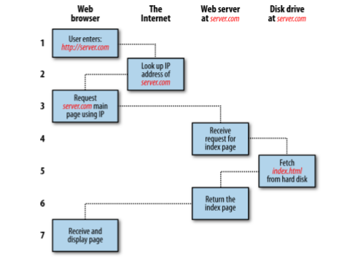
How the web works
You enter http://server.com into your browser’s address bar.
Your browser looks up the IP address for server.com.
Your browser issues a request for the home page at server.com.
The request crosses the Internet and arrives at the server.com web server.
The web server, having received the request, looks for the web page on its disk.
The web page is retrieved by the server and returned to the browser.
Your browser displays the web page.

Slide 10
The Old School way

Slide 11
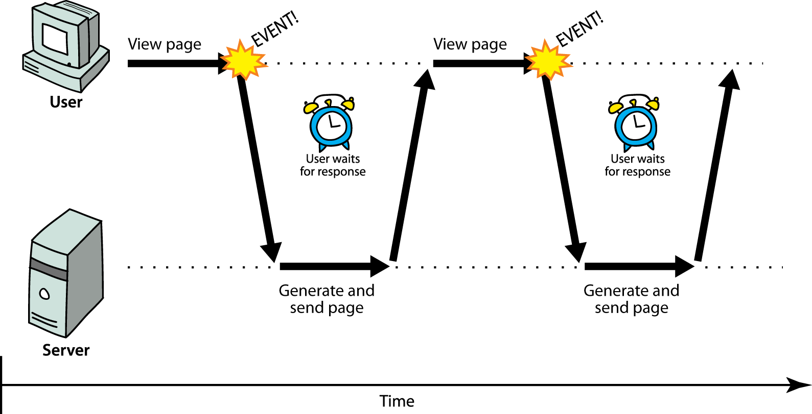
Long ago in a distant land…

Slide 12
Synchronous way
The user must wait while full content loads
Standard way of communication in web pages (click – wait – refresh)
Still valid in every cases – one request and one response: but only one at a time
Be careful what you put in your HTML and how: every external resource (image, script or stylesheet) means one request and also a delay in loading

Slide 13
Pro & Cons
Easier to program – mainly think on server side
Not really depends on the client itself
Extremely SLOW
Each new page requires fully loaded content – terrible user experience

Slide 14
The asynchronous way

Slide 15
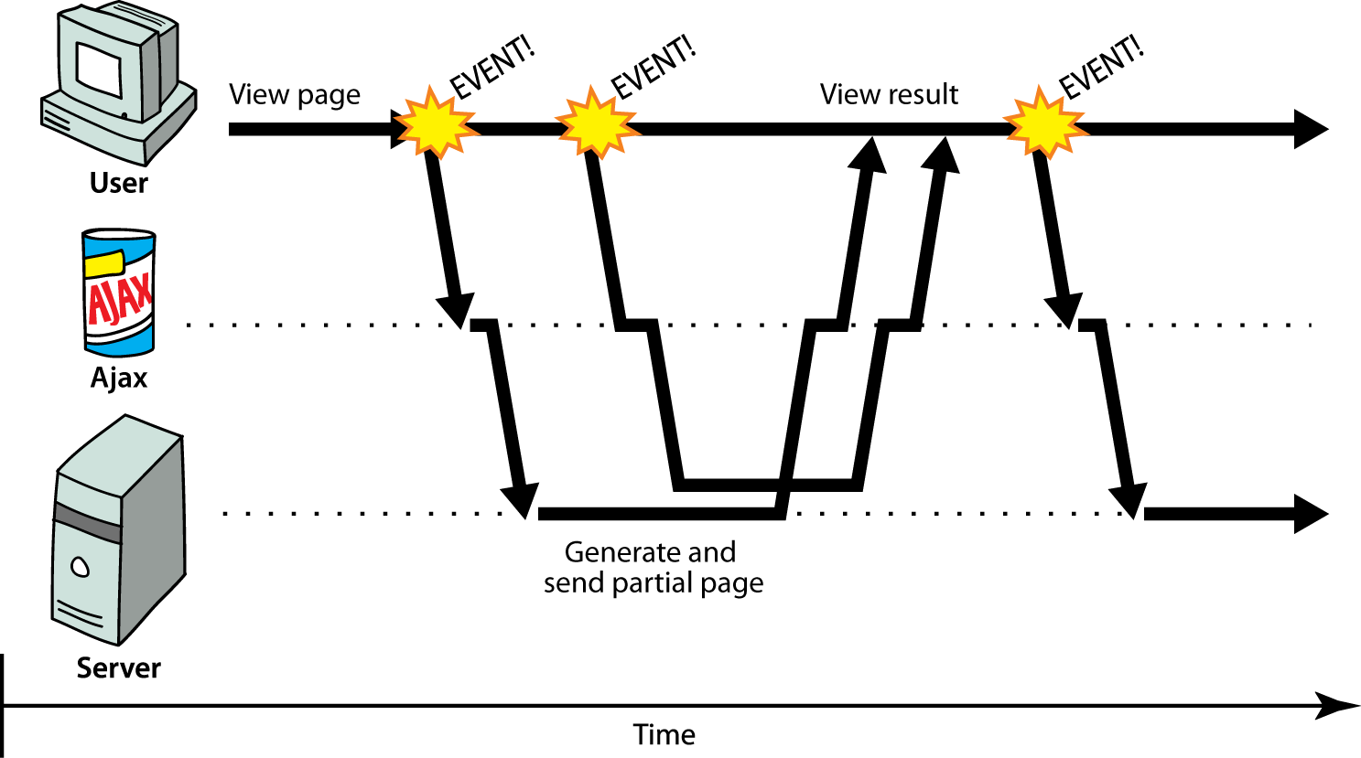
Web 2.0

Slide 16
Rich (heavy-fat-thick) Client
Client-server communication in the background
Dynamically update page without reloading
Transparent to the user
Content of fetched file can be put into the current web page using DOM manipulation

Slide 17
Pro & Cons
Fast – not everything is needed at the first load
User friendly – dynamically added new items (like on Facebook/9gag)
Requires different kind of thinking on both side – Service Oriented Architecture
Heavily based on JavaScript – client-dependent
Client error might disable a functionality and/or a complete page
Hell of loading indicators

Slide 18
Limitations
Same Origin Request Policy - can only load from the same domain via the same protocol
Cross Origin Resource Sharing (CORS)
Hard to handle manually loaded scripts
SEO can cause difficulties
Disabled JavaScript equals disabled functionality

Slide 19
ASYNCHRONOUS FUNCTIONS & Callbacks

Slide 20

Asynchronous functions
function printNumber (num) {
setTimeout( function () { console.log("Your number: ", num) },
Math.floor(Math.random() * 100) + 1 )
} function countToThree () { printNumber(1);
printNumber(2);
printNumber(3); }
countToThree(); // What is the result of this? Why?

Slide 21
JavaScript concurrency model introduction
JavaScript has a concurrency model based on an so called „event loop”
Three main parts: heap, stack and message queue.
At some time during the event loop, the JS runtime starts processing the messages on the message queue
Event handlers, XMLHttpRequest and timers can push messages to the message queue
Each message has a callback associated with it, which will be invoked upon processing.

Slide 22
Callbacks
Functions are first class citizens in JavaScript
That means we can use them as function parameters
A callback is basically a function that is passed to another function
The first function will call the callback
So let’s see our printNumber function with callbacks

Slide 23
function printNumber (num, cb) { setTimeout( function () { console.log("Your number: ", num) cb()
}, Math.floor(Math.random() * 100) + 1 ) }
function countToThree () { printNumber(1, function () { printNumber(2, function () { printNumber(3, function () {}); });
}); }
countToThree(); // Is this better?

Slide 24
ajax

Slide 25
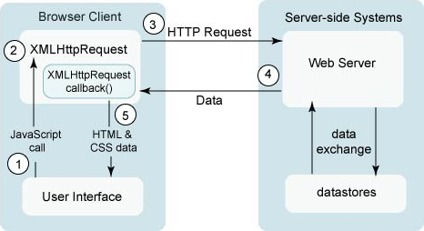
A typical AJAX request
Click event handler
Create a request, register callback
Call a service
Server is answering…
Event – answer arrived; run callback function
Remember:
Your callback is what really process the data
Can’t work with a value you don’t have yet

Slide 26
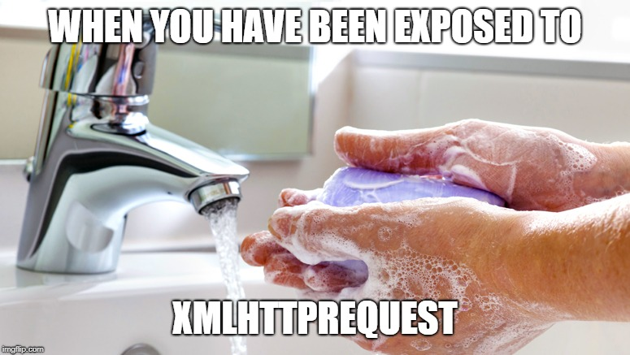
Native JavaScript – XMLHttpRequest (XHR)
Don’t Panic
var ajax = new XMLHttpRequest();
ajax.onreadystatechange = function(){
if (ajax.readyState == 4 && ajax.status == 200) {
var response = JSON.parse(ajax.responseText);
ShoppingCart.updateQuantity(response.quantity);
} else if (ajax.status != 200) {
Notification.error("Unexpected error");
}
};
ajax.open("post", "/api/cart", true);
ajax.send(JSON.stringify({
productId: 5,
quantity: 1,
userId: 1
}));
And carry a towel
This would be the code if you would like to handle the response only in native JavaScript
Frameworks and JS tools helps a lot in this – so don’t worry, you won’t meet this if you’re using one.

Slide 27
PROMISEs

Slide 28
The Promise
A promise is an object representing the eventual completion or failure of an asychronous operation.
A Promise is in one of these states:
pending: initial state, neither fulfilled nor rejected.
resolved: meaning that the operation completed successfully.
rejected: meaning that the operation failed.
Until ES6 JavaScript did not have native implementation for promises
Pre ES6, the concept Promise was more like a design pattern, if you wanted to use it you had to use third-party libraries like jQuery or Q, frameworks that had the implementation (like AngularJS) or implement it yourself.

Slide 29
How to work with promises?
In asynchronous calls you have to work with data you don’t have yet – simple variable assignment is not working!
You have to WAIT until the data arrives – it can be done via the THEN method
It’s also possible an error occurs and it has to be handled too – never forget it, a promise has to be accepted or rejected within a time
You can store data within promises too, so no other AJAX request has to be sent out – performance

Slide 30
The Promise object
With the standardisation of ECMAScript2015 (more commonly known as ES6), native support for promises was introduced for JavaScript
Syntax: new Promise(function (resolve, reject){ ... })
The promise constructor takes a function with two functions as parameters for happy and sad cases – this function is called the executor
The executor is called immediately (even before creating the new promise object), does some asynchronous work then calls resolve if everything went fine, or reject if some error occured.
The Promise prototype has the well known then, catch and finally methods for handling the result of the Promise

Slide 31
Counting with Promises
function printNumber (num) { return new Promise(function (resolve, reject) { setTimeout( function () { console.log("Your number: ", num); resolve();
}, Math.floor(Math.random() * 100) + 1 ); });
}

Slide 32
function countToThree () { printNumber(1)
.then(function () { return printNumber(2); // Always return promises!!! })
.then(function () { return printNumber(3);
});
}
countToThree(); // We successfully created a promise chain that will print the numbers in order

Slide 33
FETCH

Slide 34
The Fetch API
The Fetch API provides a JavaScript interface to create HTTP requests.
fetch(”https://yesno.wtf/api”).then(function (res) { return res.json(); }).then(function (data) { console.dir(data);
return data; });

Slide 35
Promise based HTTP libraries
If you want an alternative to fetch there are a couple of very good libraries, that you can use for HTTP requests, e.g:
Axios (https://github.com/axios/axios)
request (https://github.com/request)
Superagent (https://github.com/visionmedia/superagent)

Slide 36
Exercises

Slide 37
Initialize local server
When you’re done with the checkout, do the following in a command line:
npm install
node bootstrap.js
This will initialize the project resources and create a node server application on your machines
Open the following url in a browser window: http://localhost:3000
Do not open index.html manually – otherwise you won’t be able to use the ajax methods
From this point the server will handle the html files

Slide 38
Implement product list
Implement SearchProduct method described in ProductService class
Parameters: ProductSearchParameters instance
Return ajax response mapped as ProductItem
Implement searchProduct function in indexPageController
Request items via ProductService.SearchProduct passing the search parameters
Generate items list in the container using the returned ProductItem class display method

Slide 39
Implement search functionality
Implement search functionality
Update the indexPageController initiliaze method
ProductSearchParameters.searchTerm has to be updated
Add listener to form submit and search for products
(return false at the end of listener to prevent page reload)

Slide 40
Implement category filtering
Create public method getProductsByCategory in ProductService or modify the search method – use ProductSearchParameters
API route for categories:
/api/products/categories – all existing categories
/api/products/category/<category-name> - products filtered by the given category
Update IndexPageController initialize method
Add listeners to items in the category list
When clicked: search for category and highlight the LI item by adding an active class
Only one category can be active at one time

Slide 41
Thank you for your attention!

